Slide 1
Statistics: Behavioral and EEG data
Images of Association of Behavioral and ERP Data as well as Images of statistical tests

Slide 2
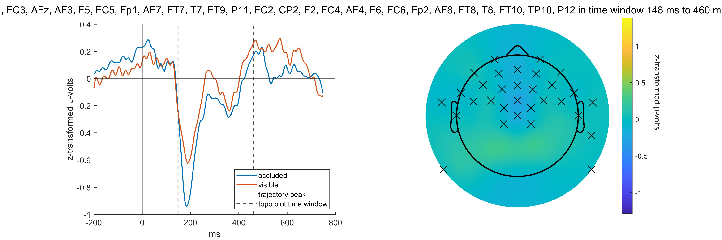
Clusters tested: occluded - visible

Slide 3
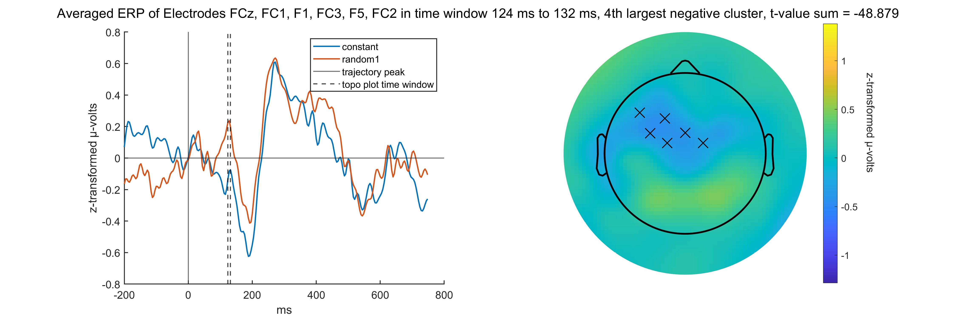
Clusters tested: constant - random

Slide 4
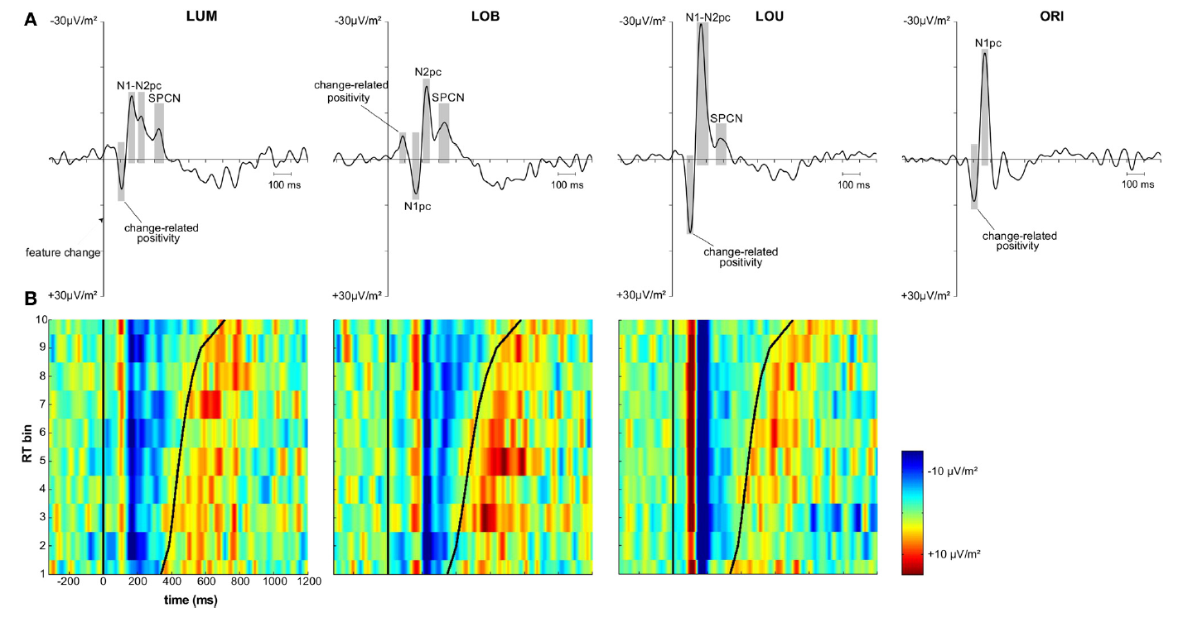
Role Model for Analysis: Paper by Sven

Slide 5
ERP images
Sorted all eeg data (all subjects, all trials, all peaks) in vincentiles (10 bins) for the two error measures pursuit latency and epoch error
For each condition separately
The two interesting clusters each at a time
See ERP images of vincenticed data

Slide 6
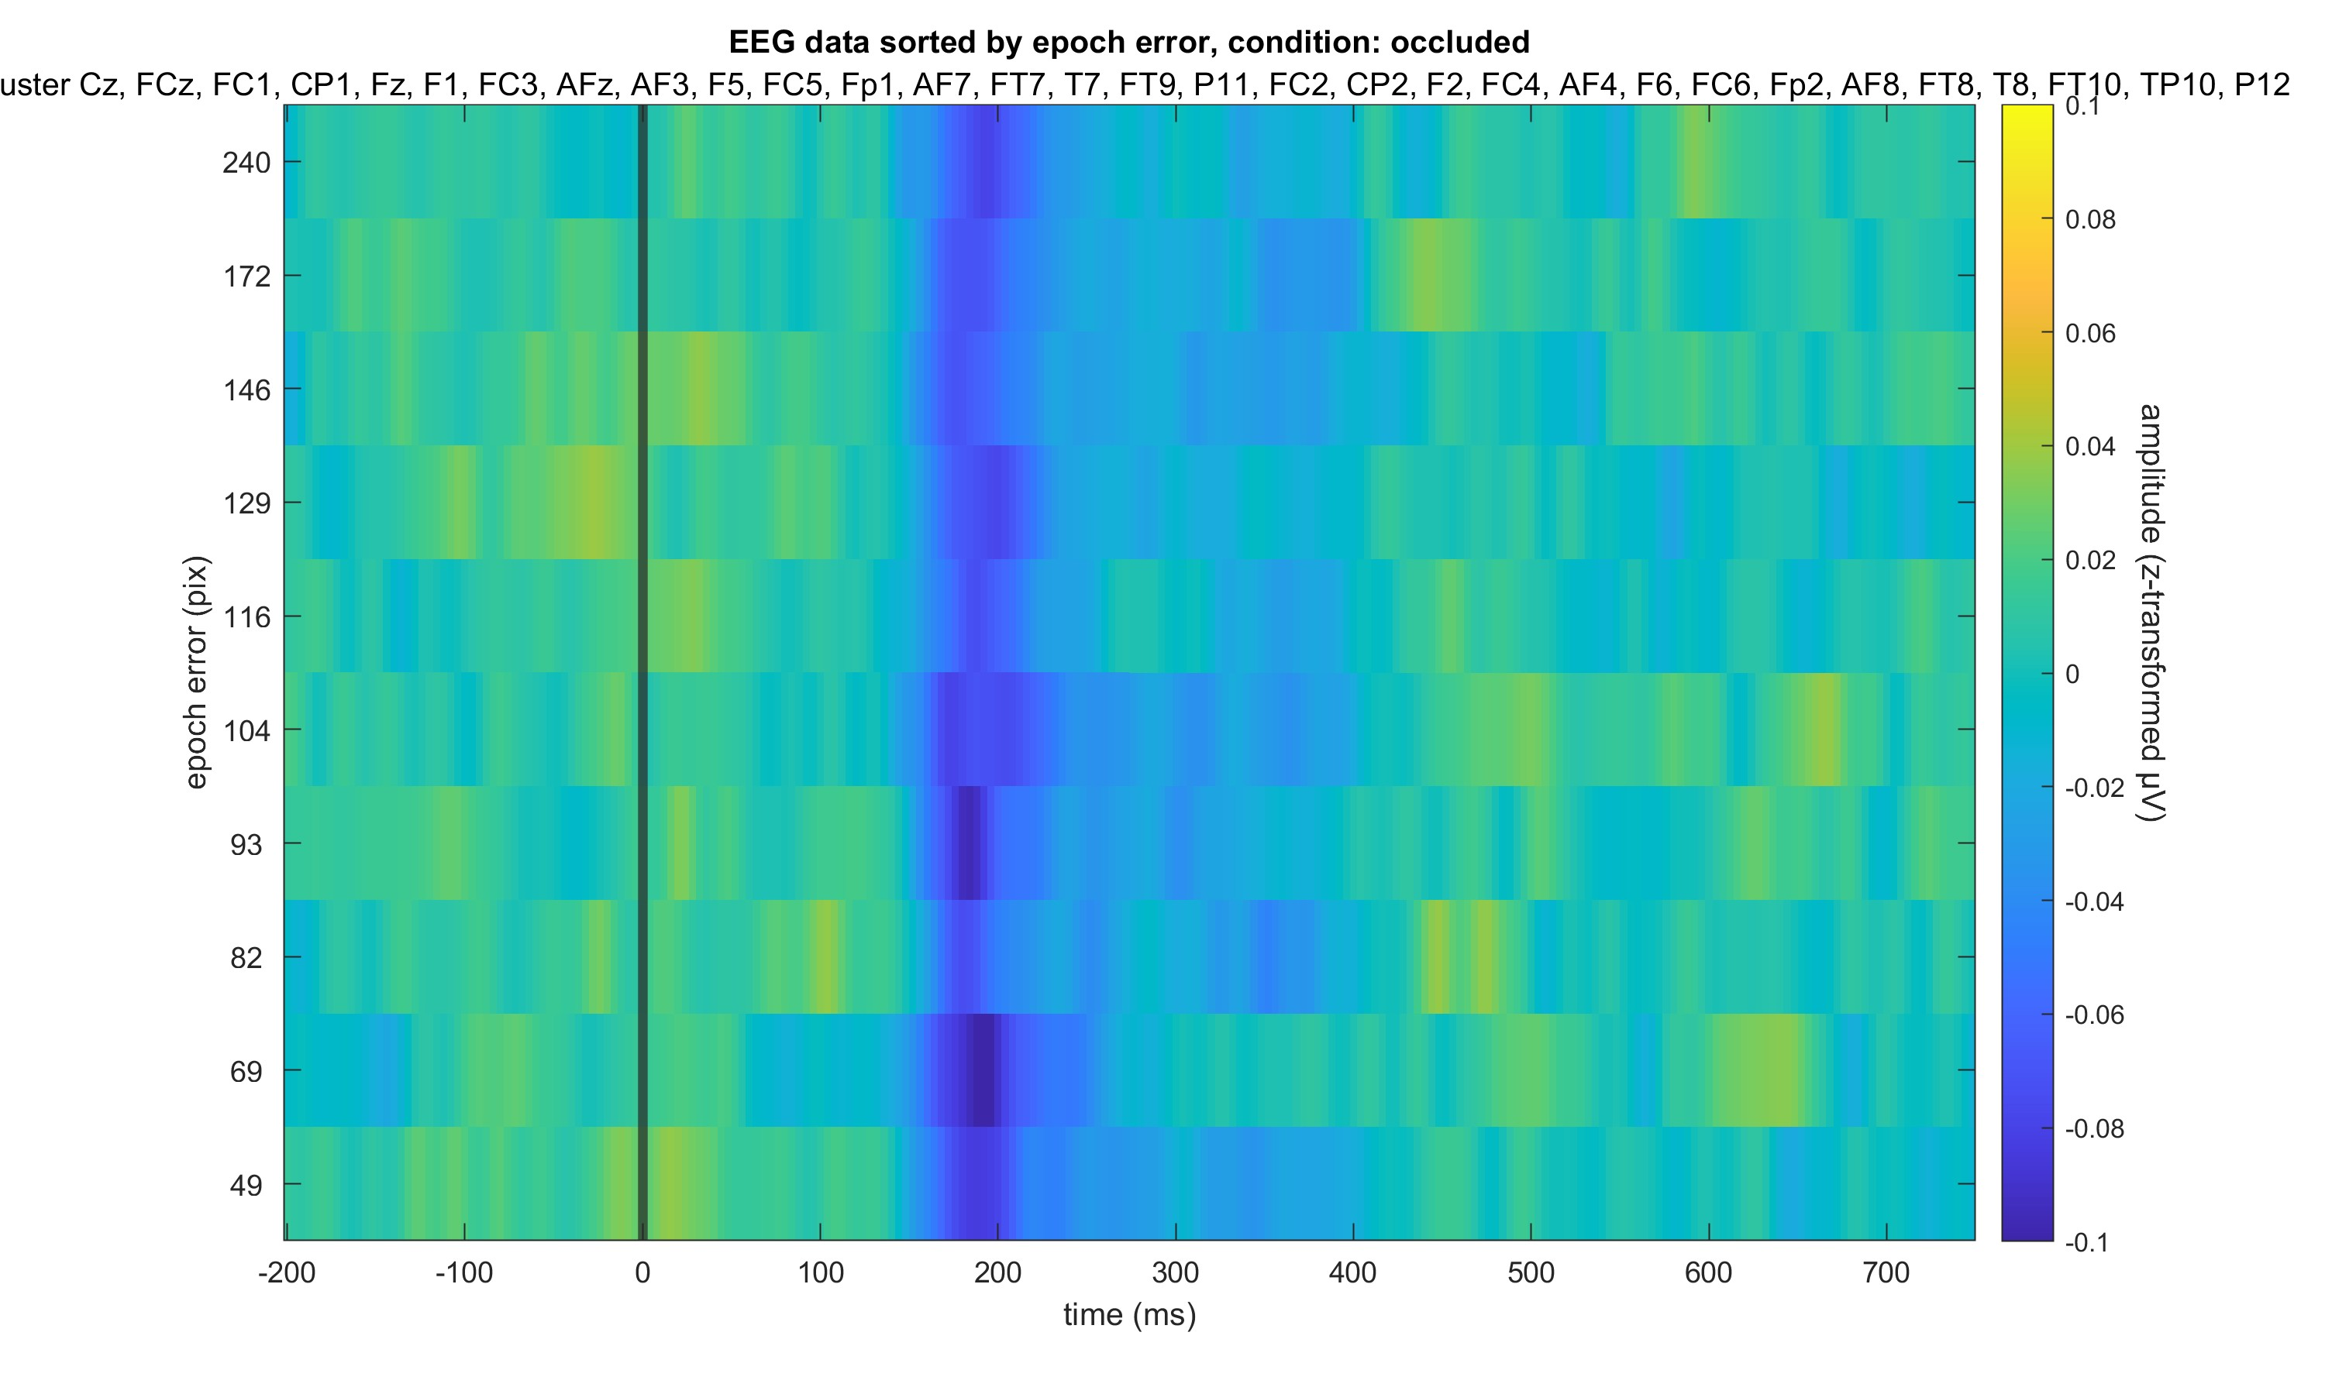

Slide 7
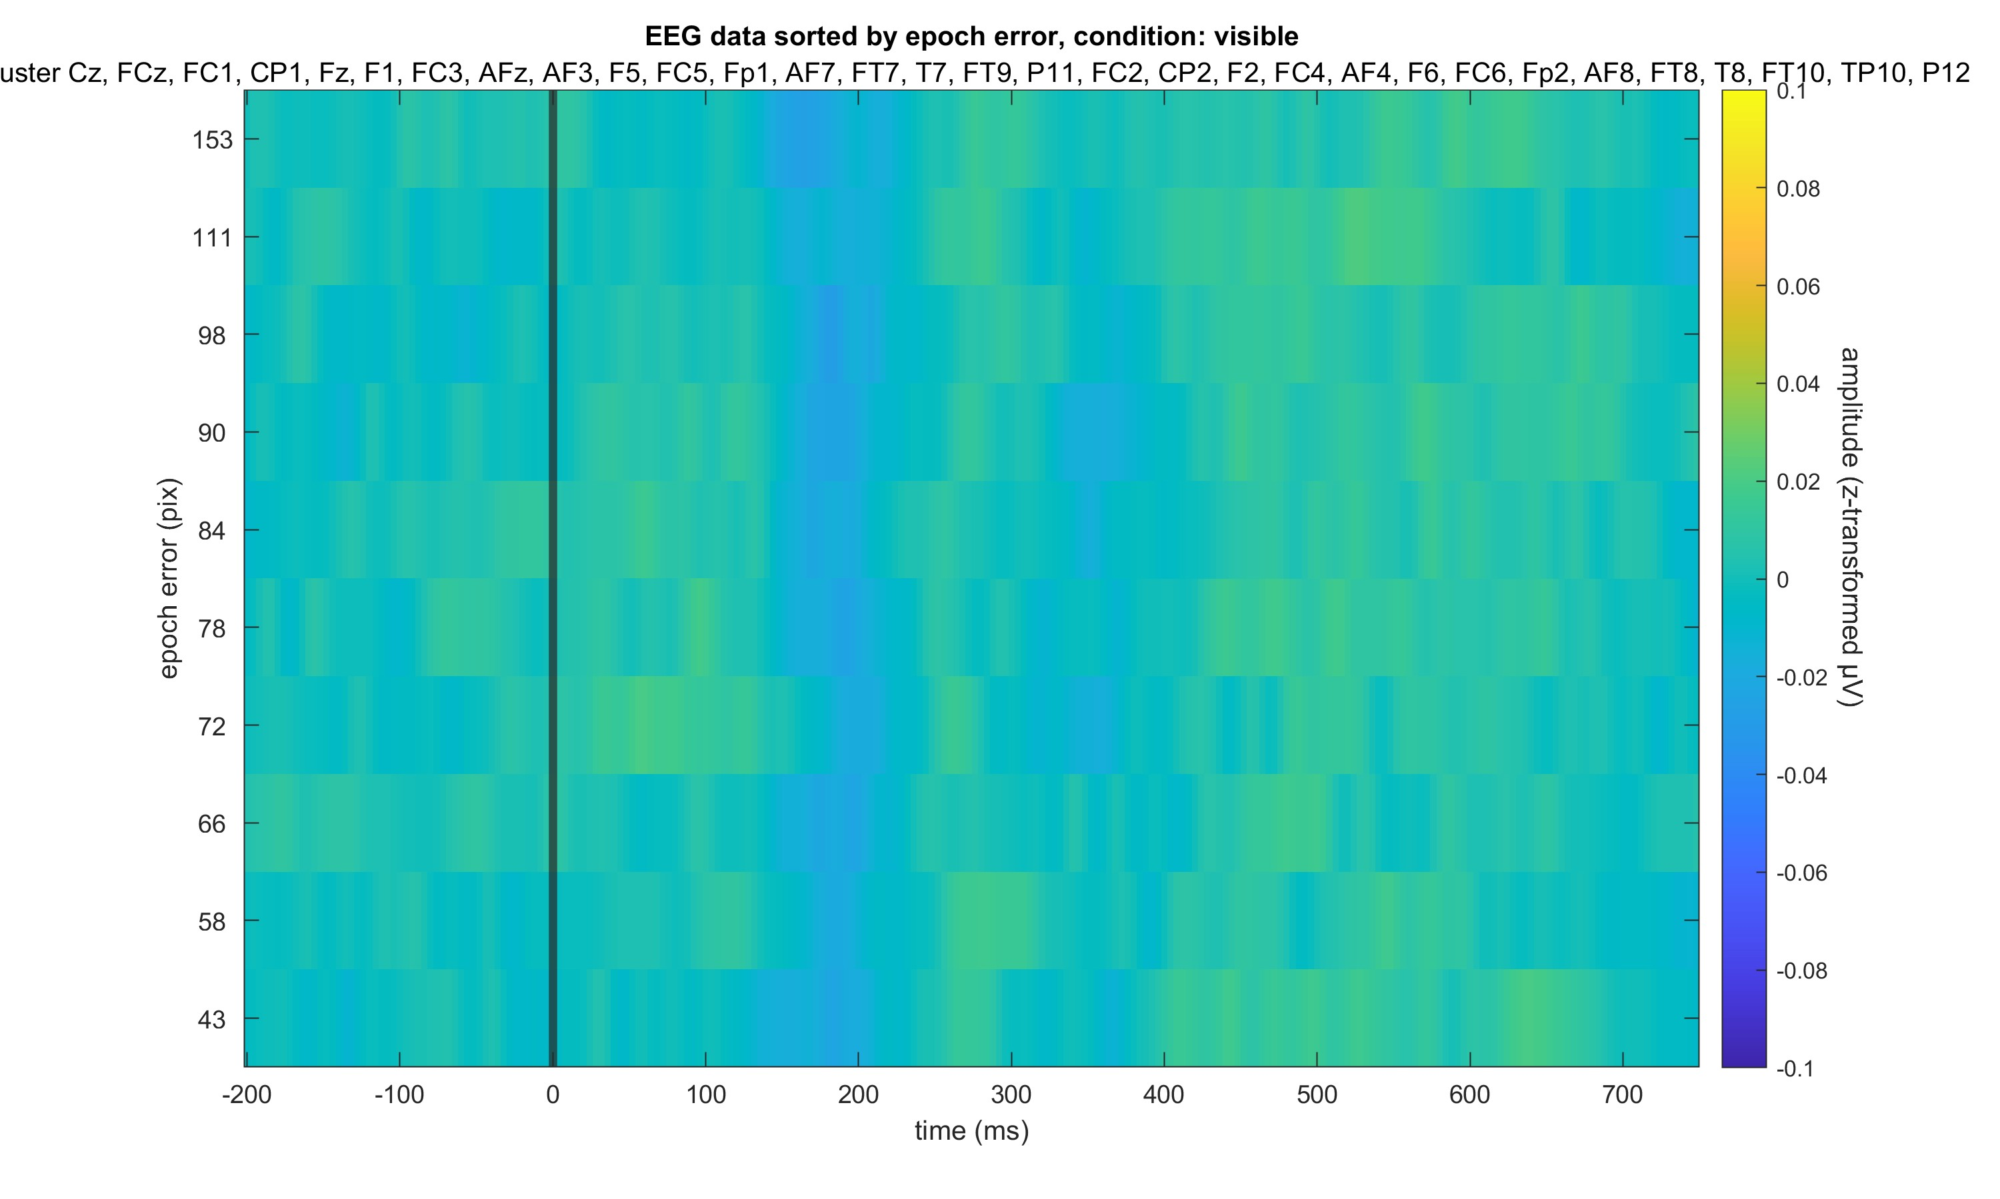

Slide 8
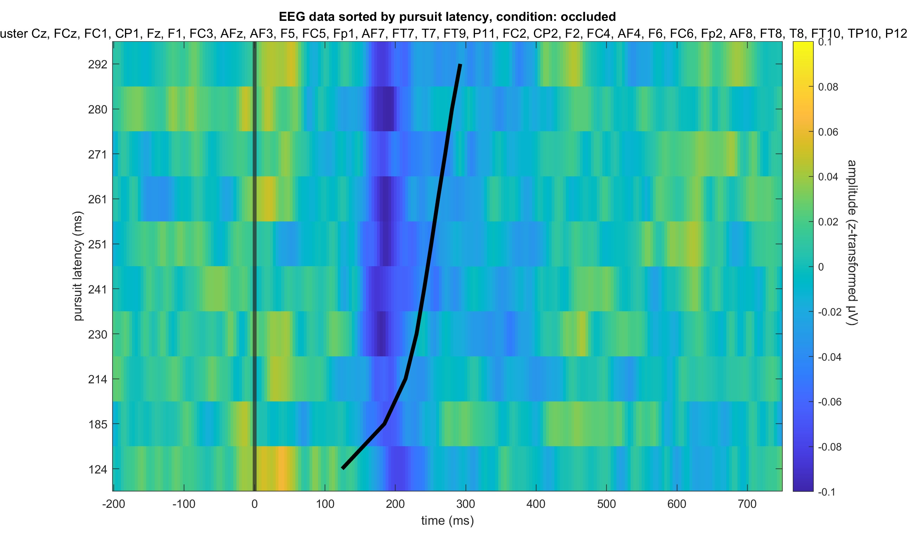

Slide 9
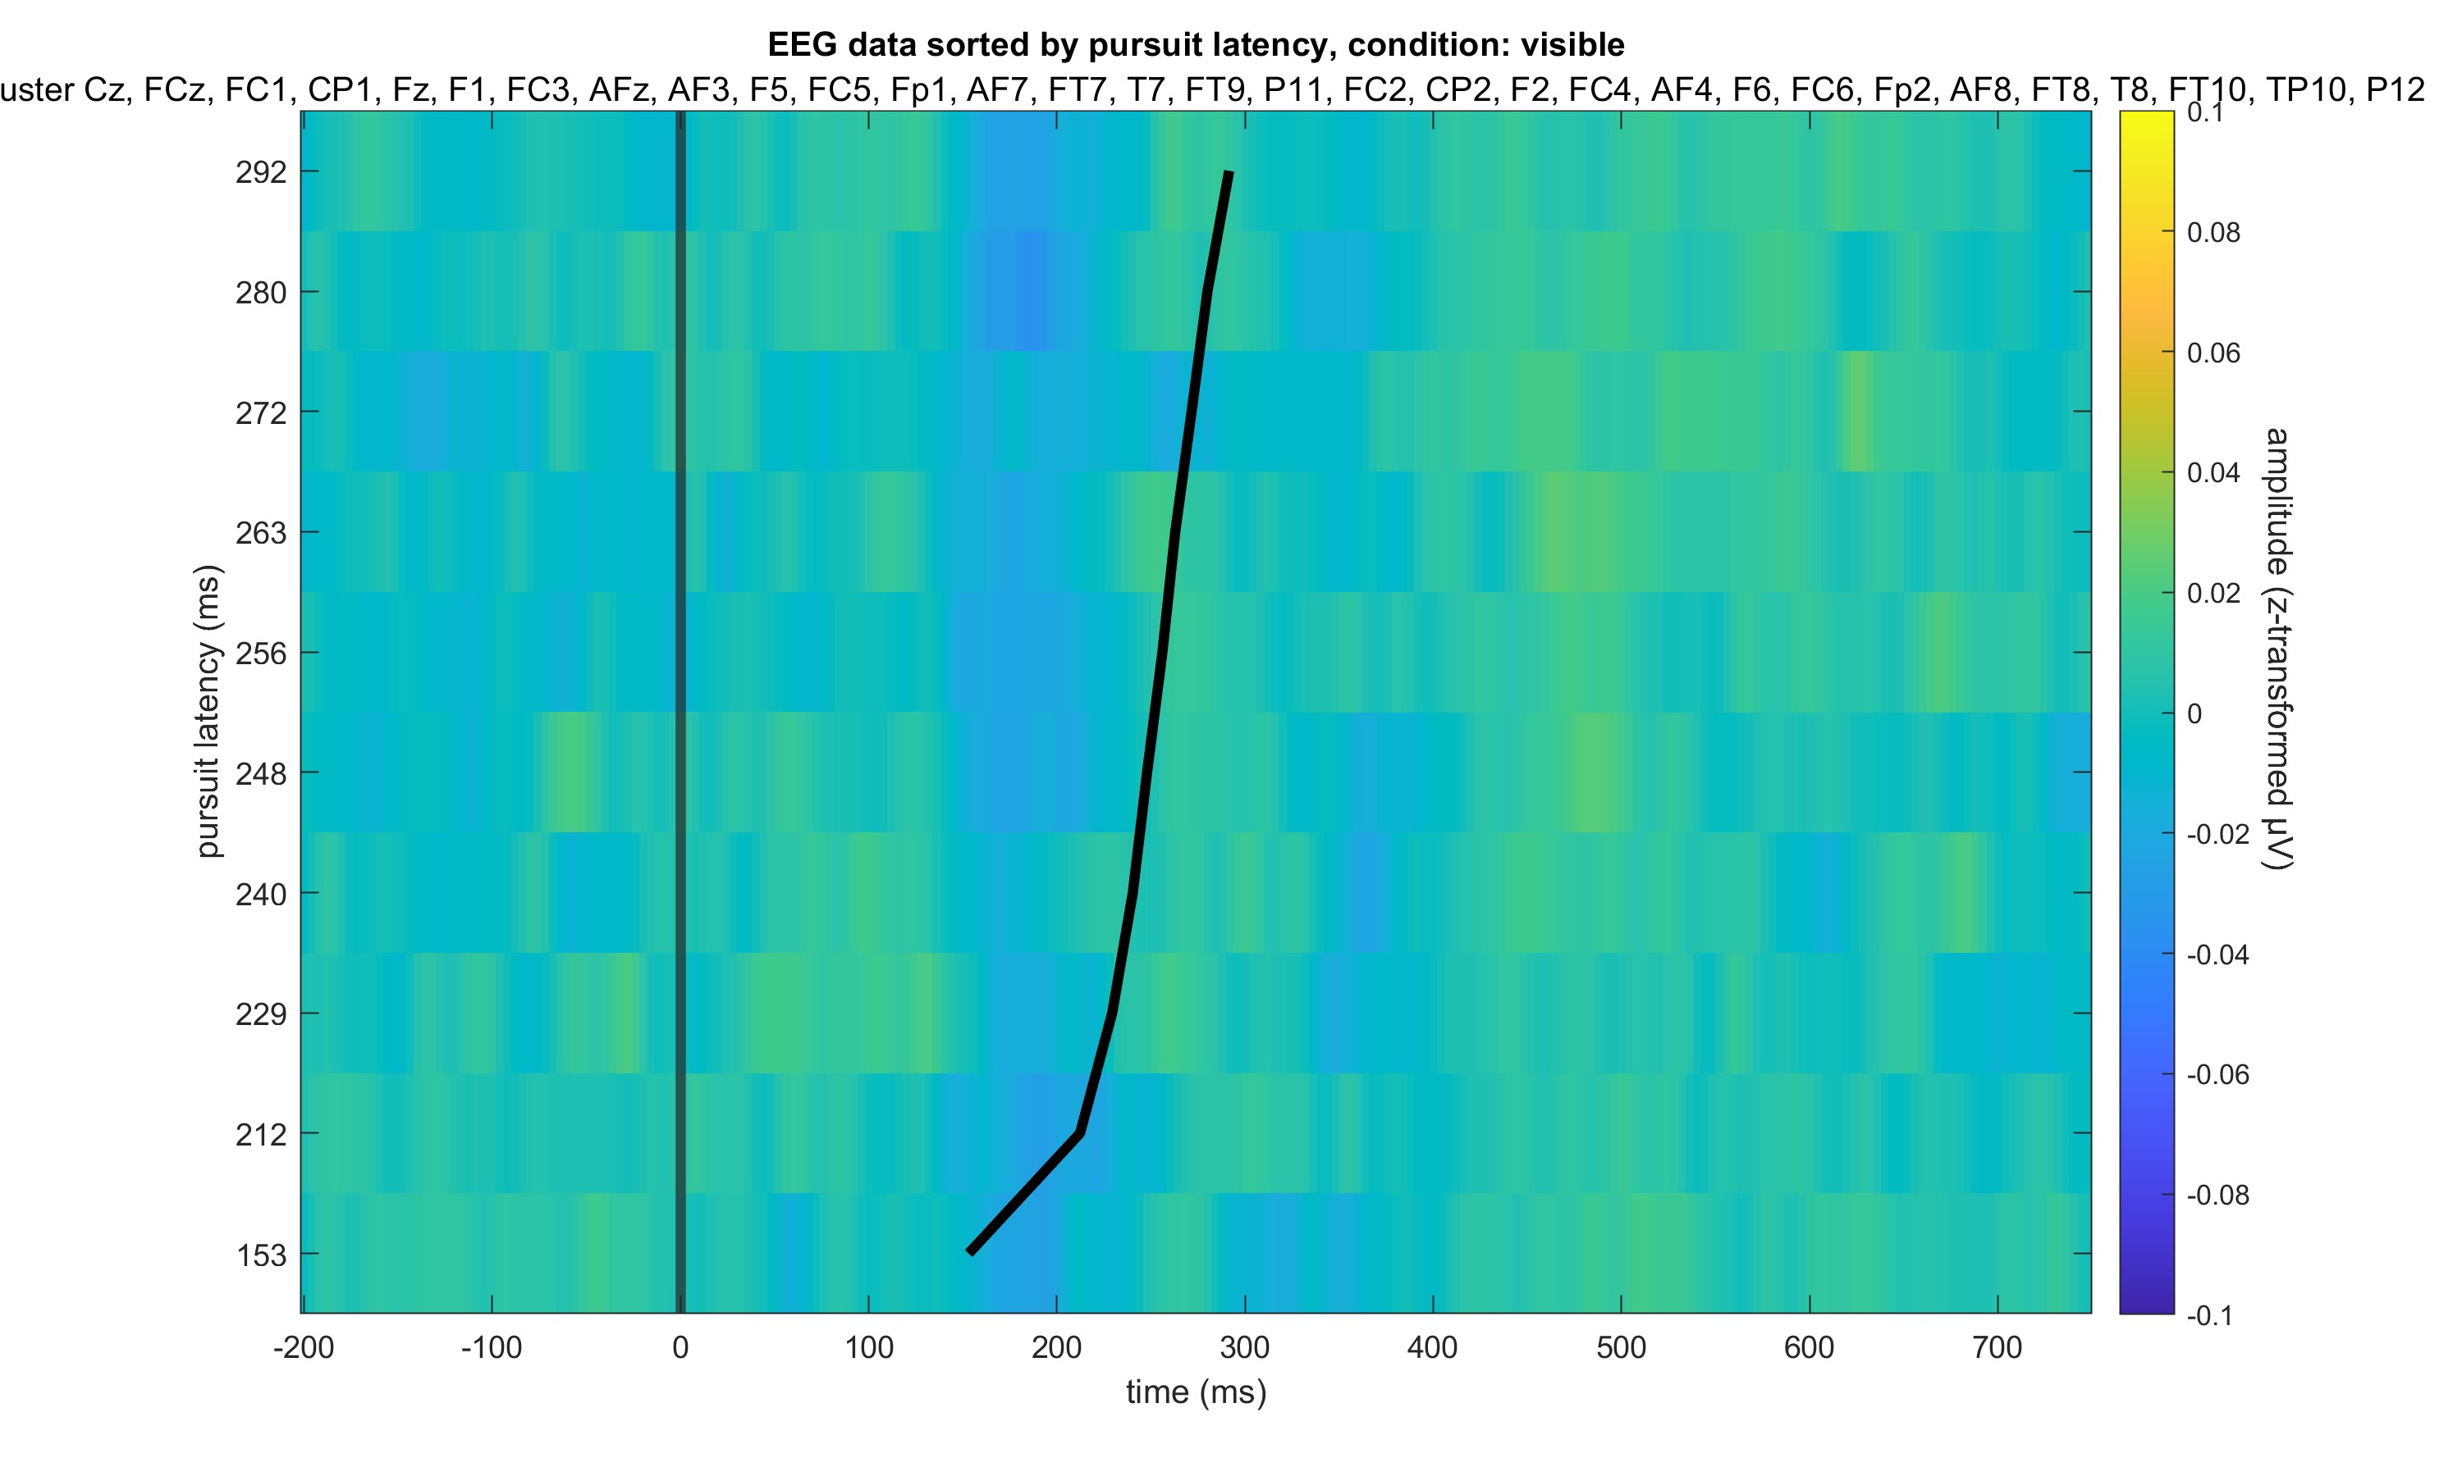

Slide 10
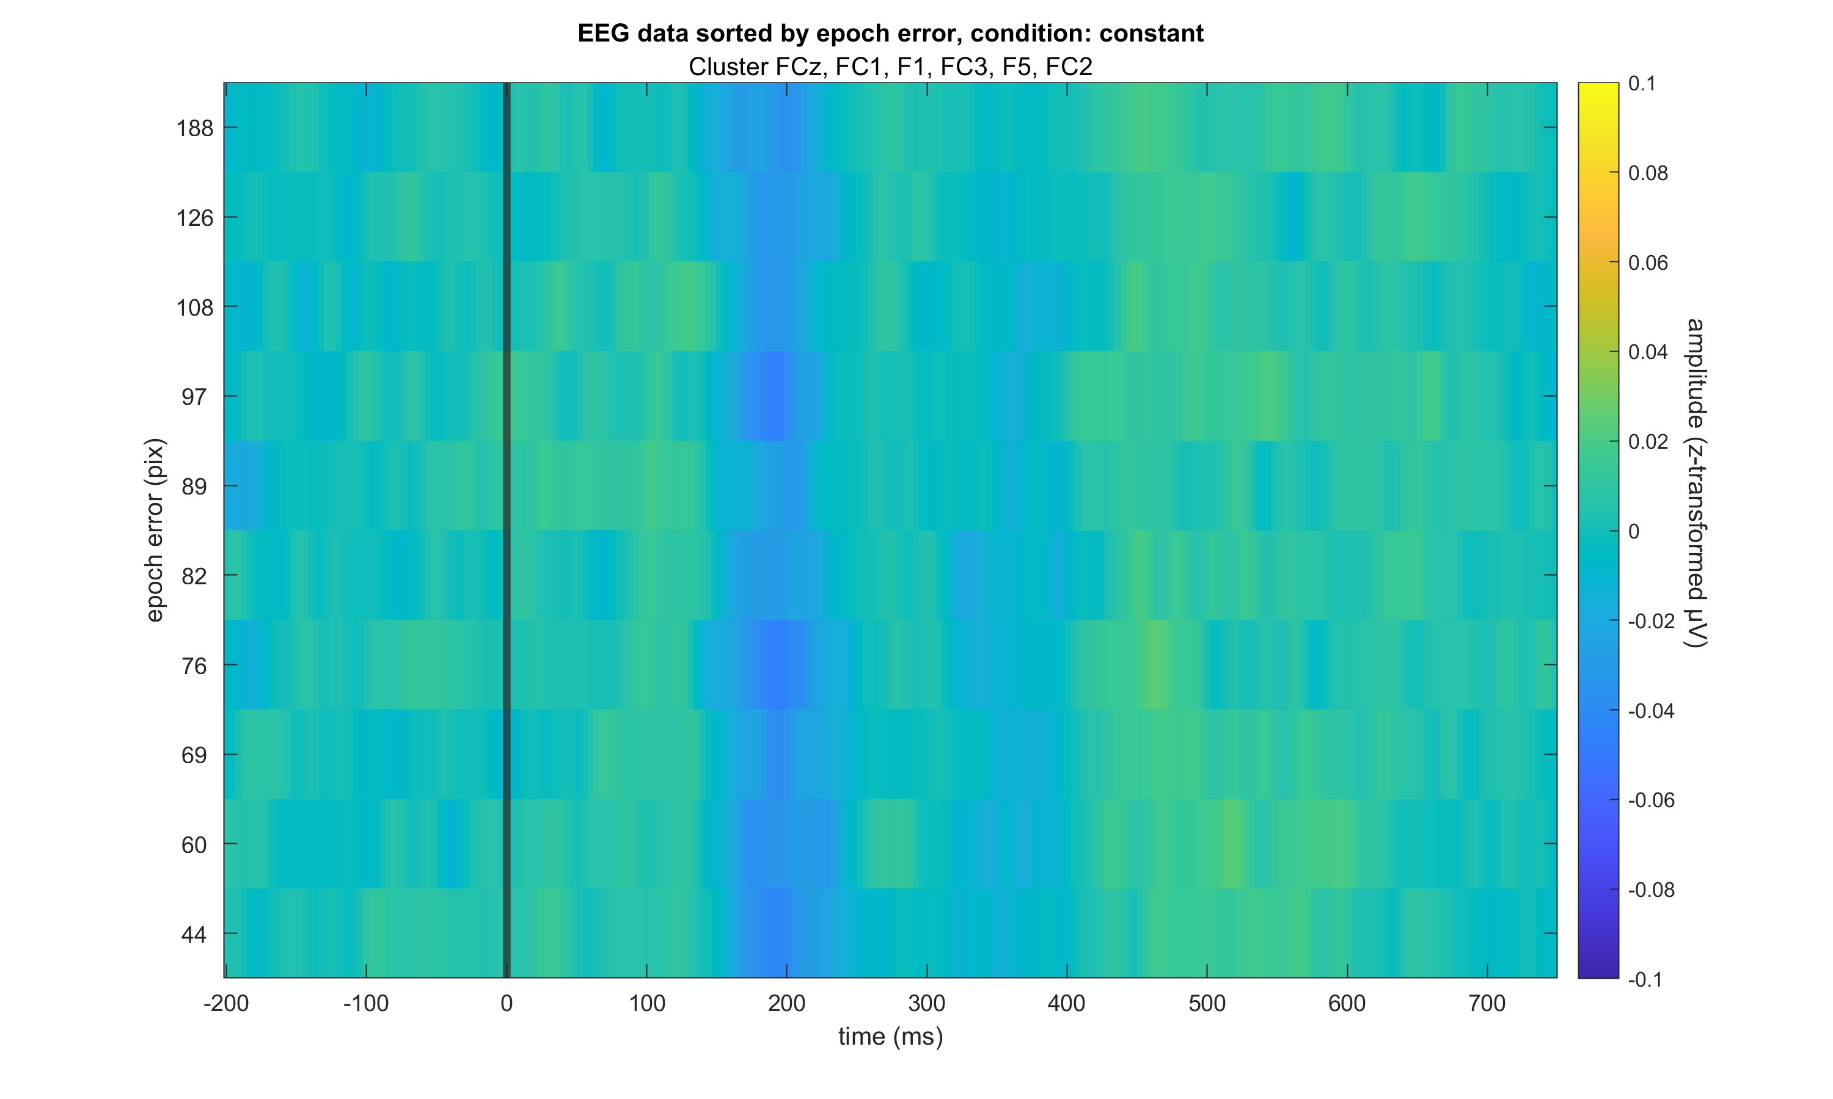

Slide 11
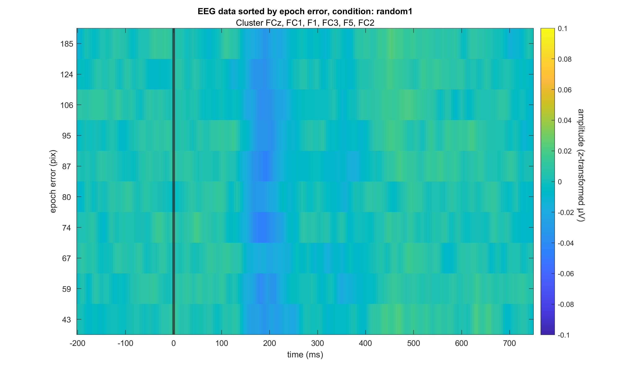

Slide 12
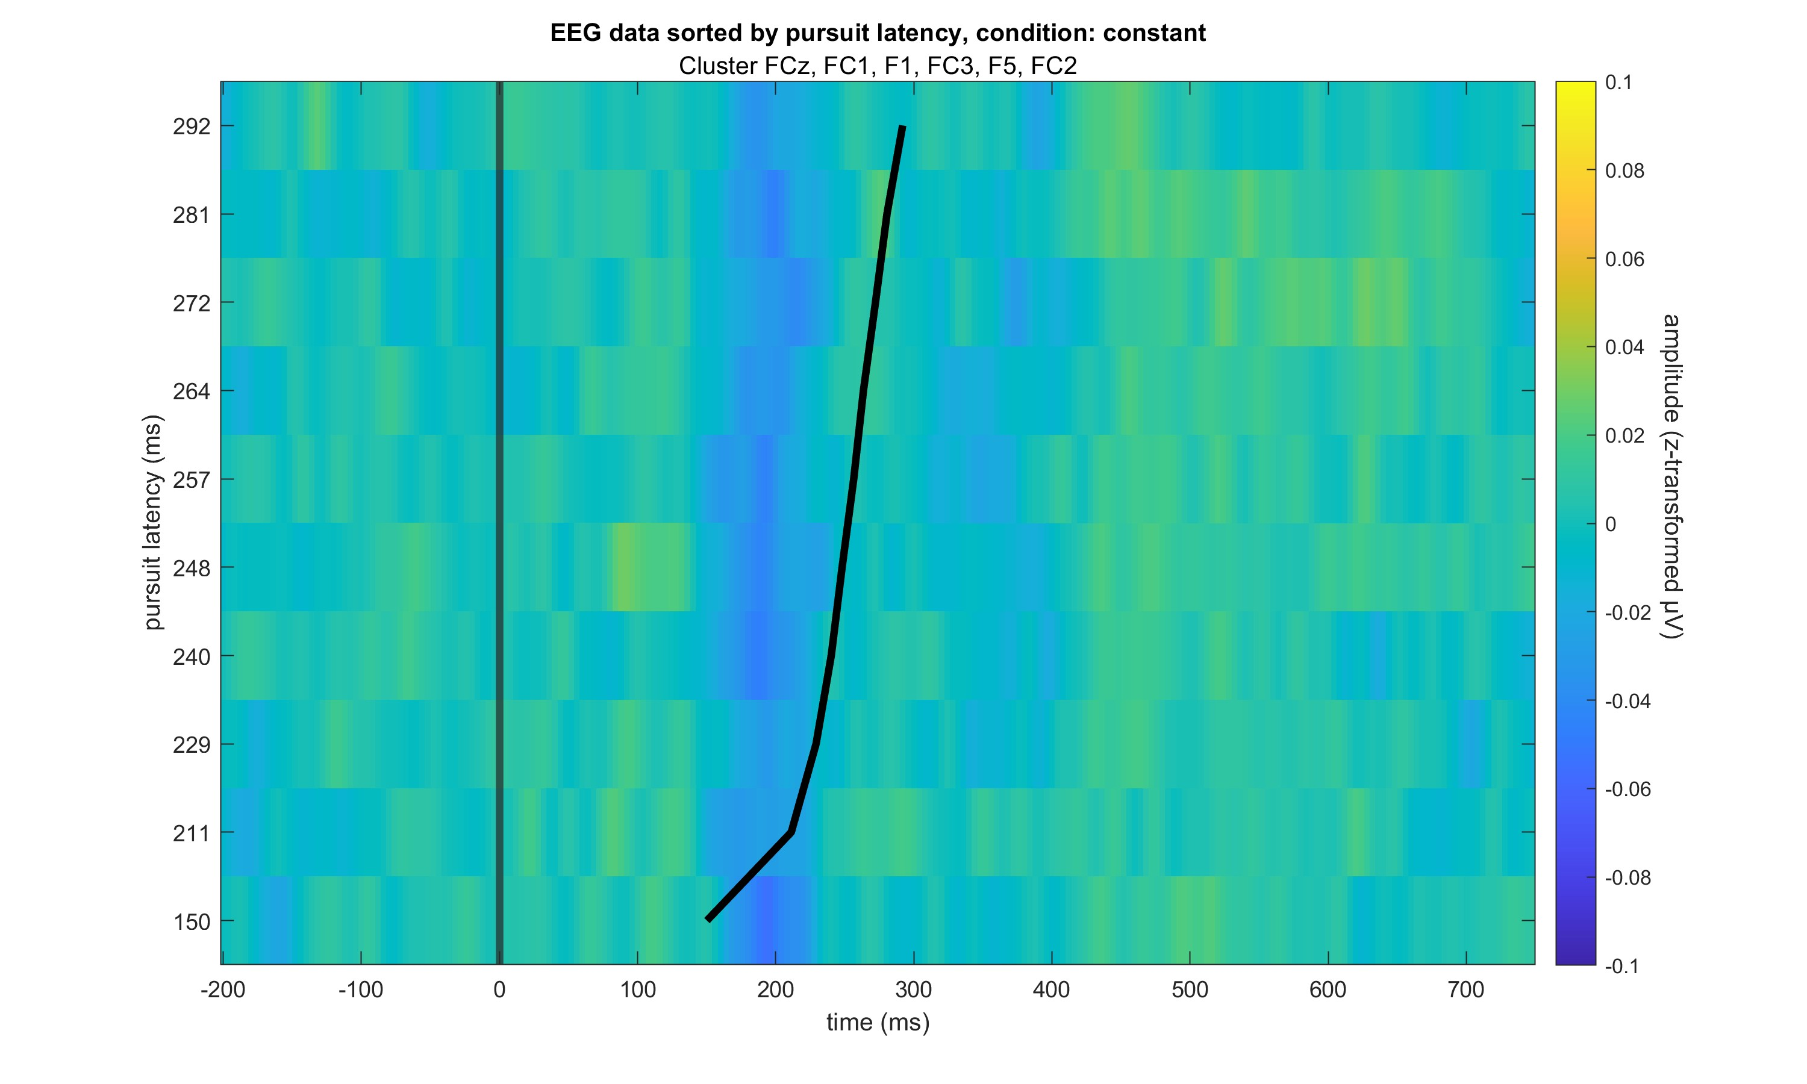

Slide 13
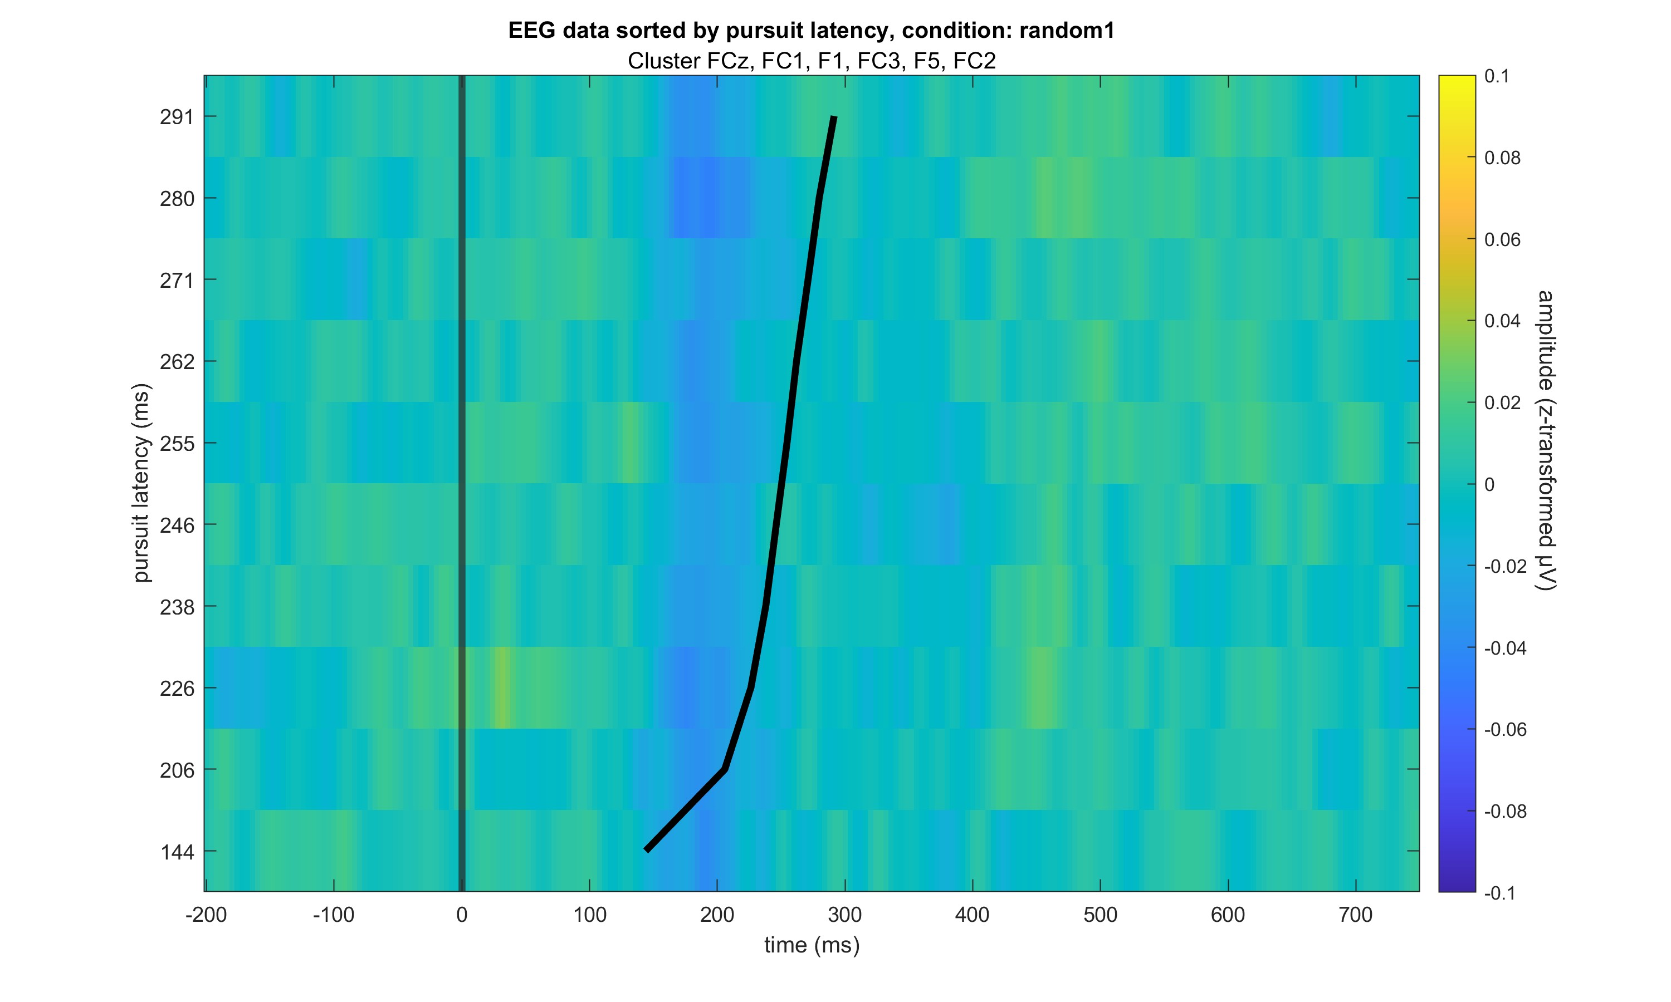

Slide 14
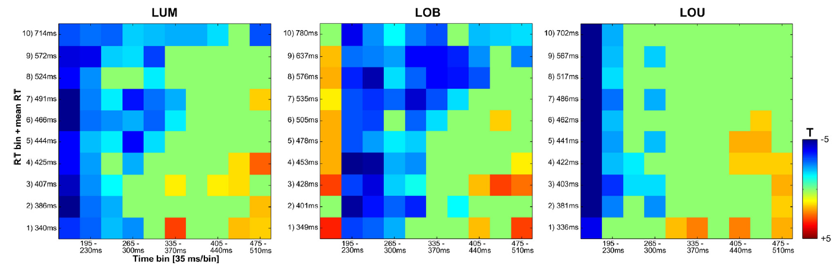
Role Model for Analysis: Paper by Sven

Slide 15
Hypothesis tests
Using the data prepared for the ERP images…
(Sorted all eeg data (all subjects, all trials) in vincentiles (10 bins) for the two error measures pursuit latency and epoch error
For each condition separately
One electrode at a time (FC3 and P3))
Split the epoched eeg data in 100 ms to 600 ms bins (10 bins)
Calculated mean of eeg data per vincentile and bin, condition and cluster
Performed bootstrapping (1000 rep) on the distribution of means
Performed a two-sample t-tests each per vincentile x bin combination for the contrasts occluded – visible and constant – random1
Per cluster
Performed FDR correction for the 10*10 tests per contrast
See images of test matrices

Slide 16
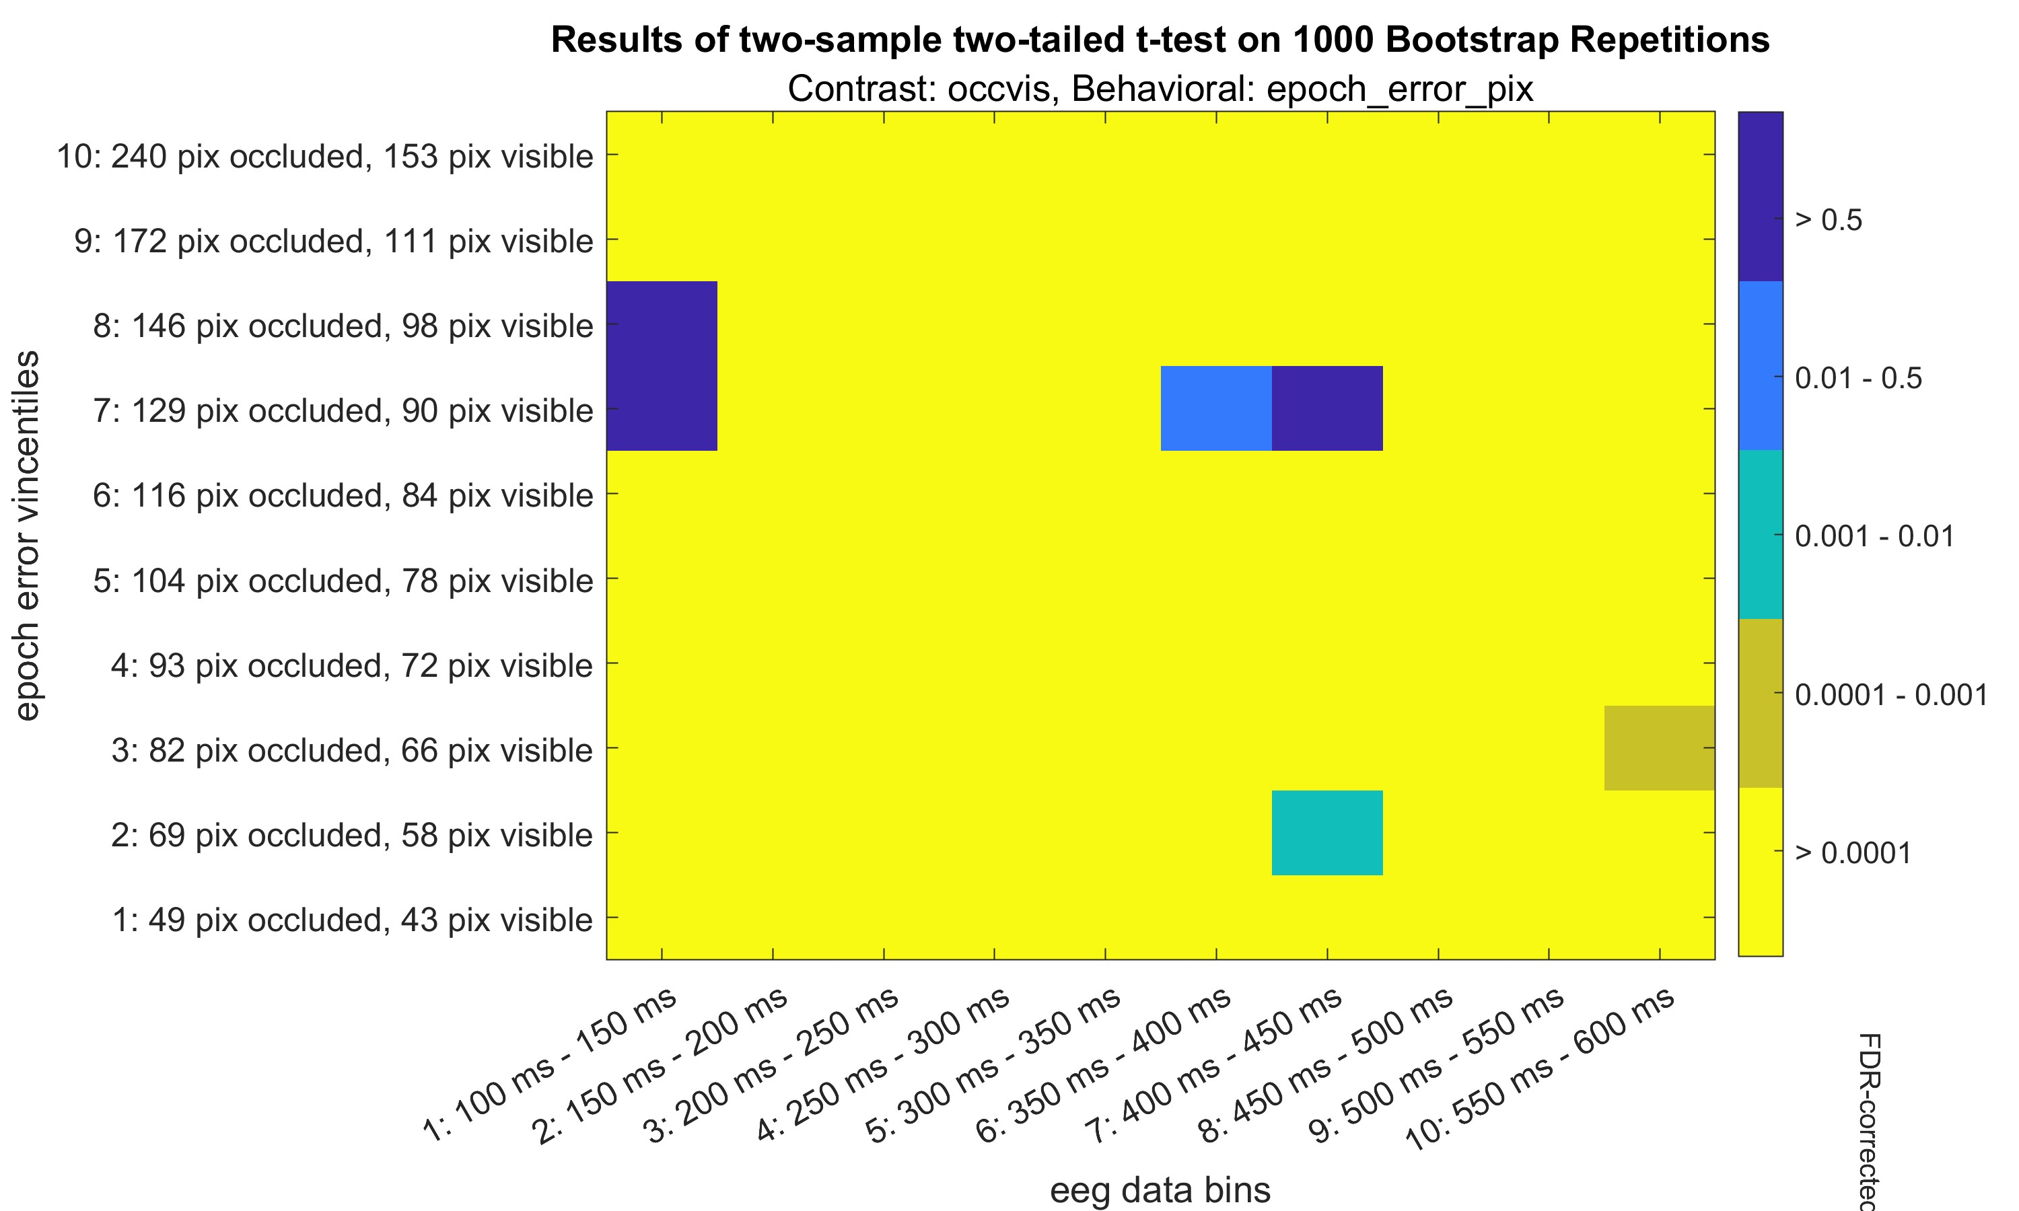

Slide 17
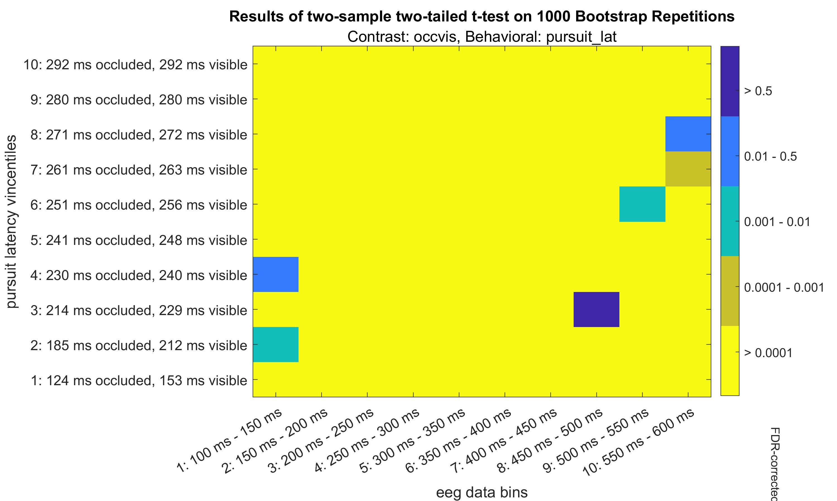

Slide 18
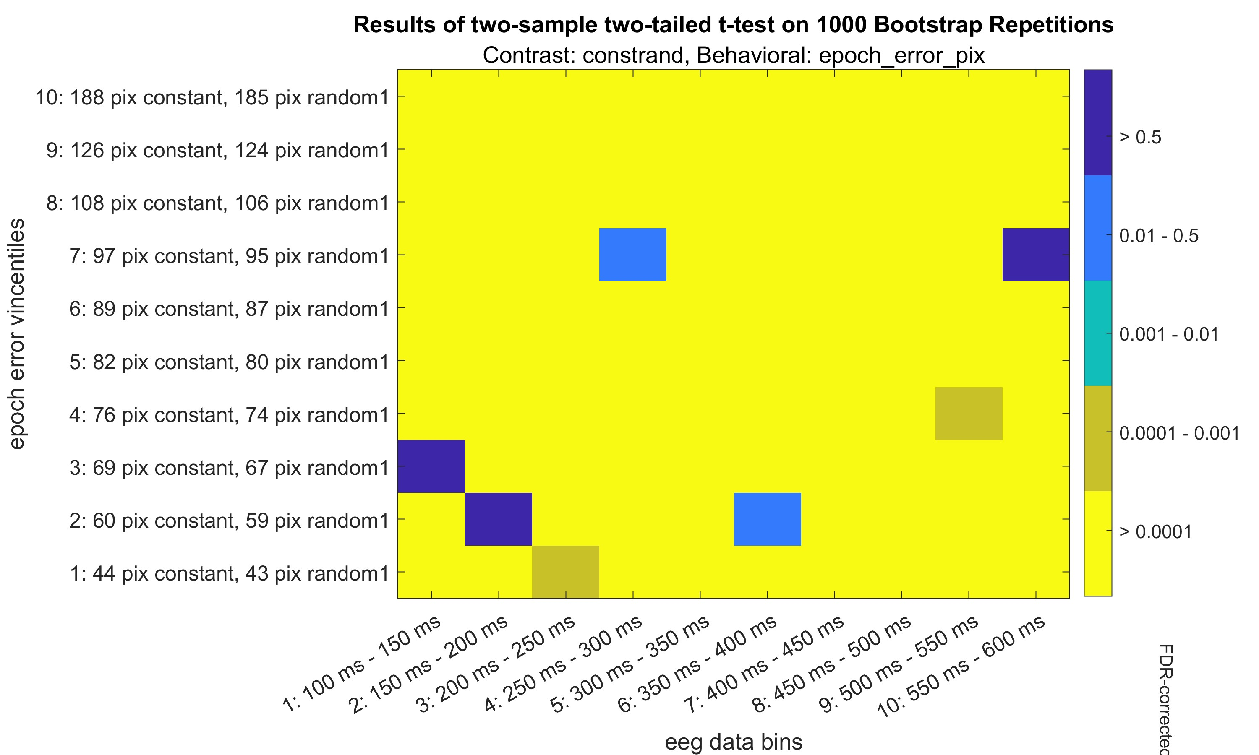

Slide 19
